Slide 1
COLOR BLOCK
assistive app

Slide 2
Color Blindness

Slide 3

Legally Blind
Color blindness affects ~ 8 : 10 % of the population
Most types are mild
How can you tell there’s a problem ?

Slide 4
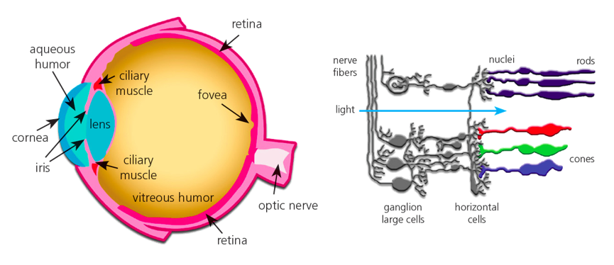
Perception to Everything

Slide 5
“FORGET COLORS !”
Subject to ridicule
Reading maps and graphs
Identifying traffic lights and signs
Judging food
Can't dress or wear makeup properly !

Slide 6
SIRI, HELP !!!
Need for an accessible application
Allows for seeing color
Science-based !

Slide 7
Apps ?

Slide 8
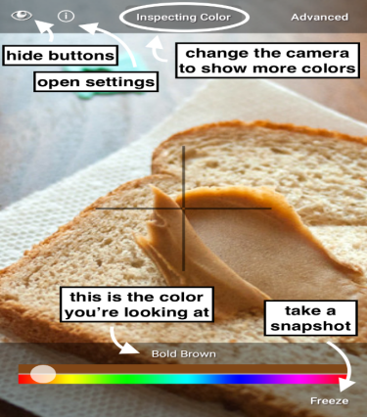
Color Blind Pal
Easy usage of common color names
Freeze and inspect
Use the phone as a portal

Slide 9
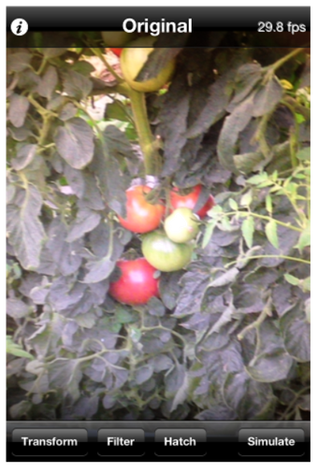
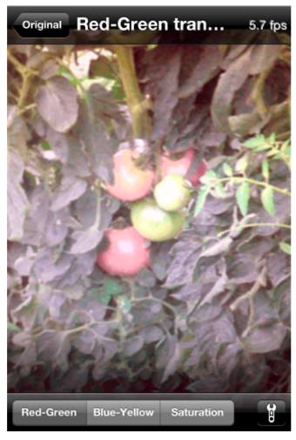
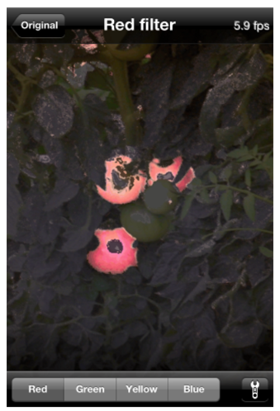
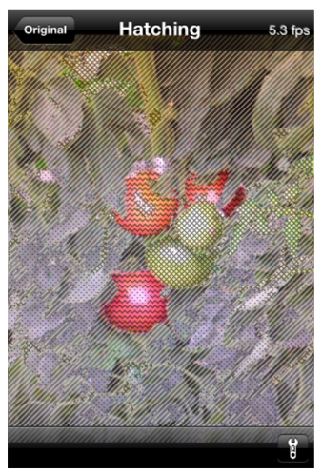
Visolve App
brighter transformations

Slide 10
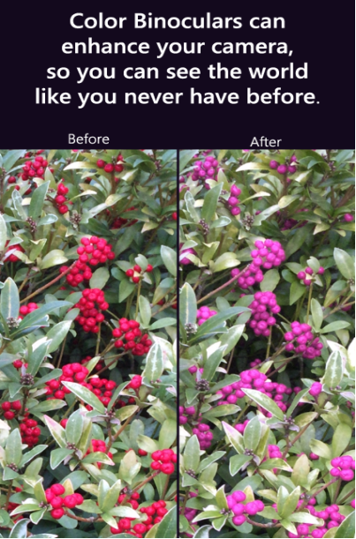
Color Binoculars
Distinguish colors in everyday lives
Replacing difficult color combinations
Supports all types of color blindness

Slide 11
Our Approach

Slide 12
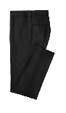
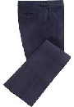
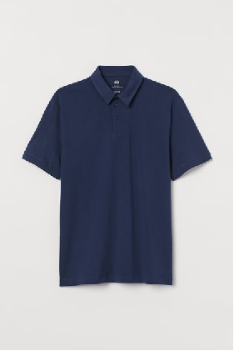
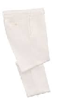

Our Application
matching ?

Slide 13
Working Pipeline
Step 1
Step 2
Step 3
Step 4
uploading & reading images of clothing items
extracting regions of interest
detecting colors of clothing items
color-matching algorithm based on color theory

Slide 14
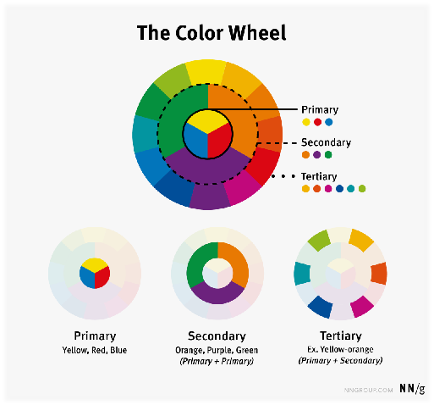
Color
Groups

Slide 15
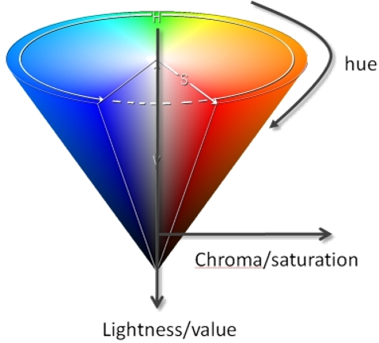
Color
Characteristics
Hue : The appearance of color itself –blue
Saturation : Purity of Color
Lighting : Brightness of Color

Slide 16
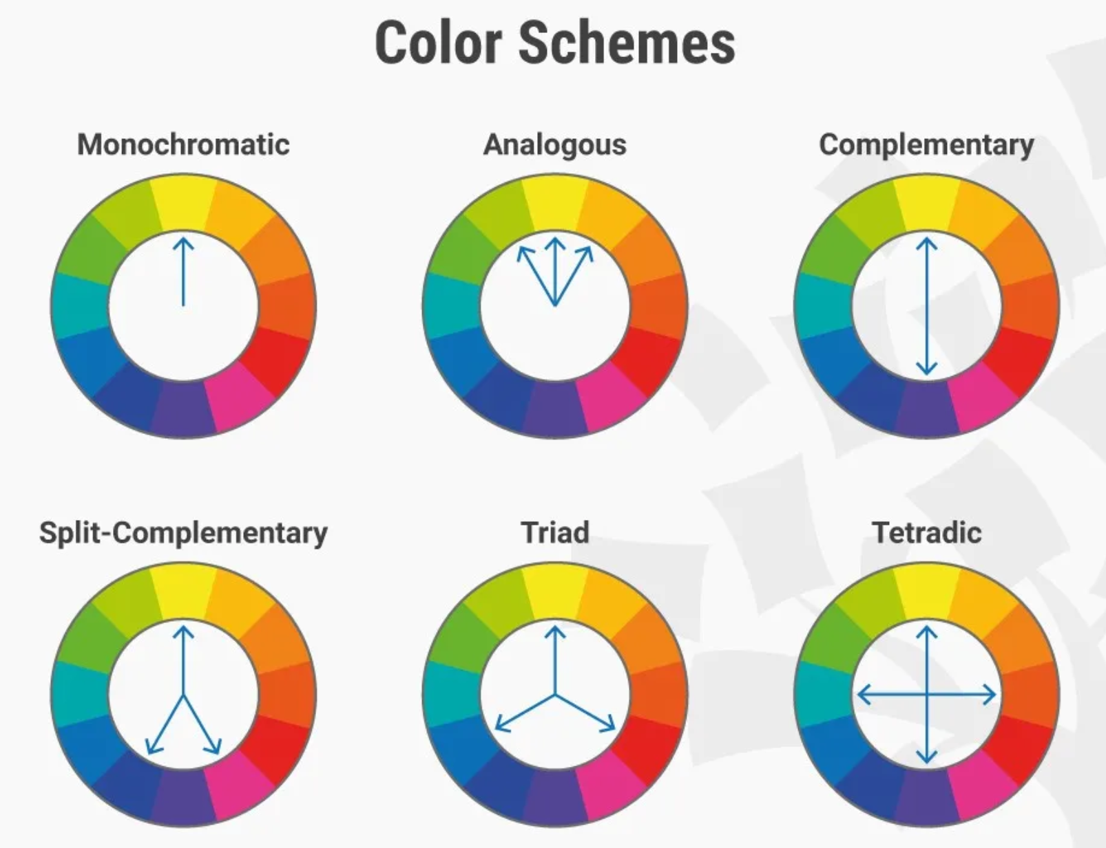
Color
Theory
Do the colors go along ?

Slide 17
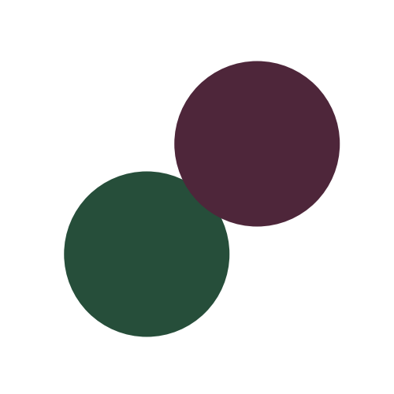
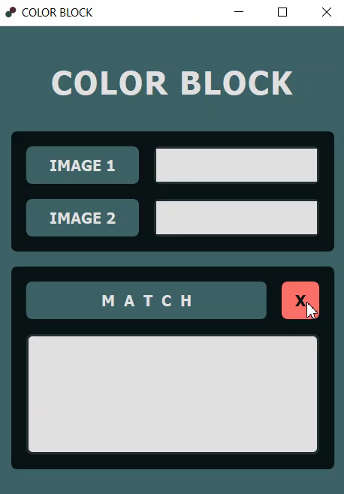
APP Demo

Slide 18
References
CODE :
https://github.com/mariam-bebawy/SBME_REHAB_ColorBLock/
APPS :
https://colorblindpal.com/
https://www.ryobi.co.jp/products/visolve/en/
https://www.microsoft.com/en-us/garage/profiles/color-binoculars/
OTHERS :
https://www.colorsexplained.com/color-theory/
https://www.nei.nih.gov/learn-about-eye-health/eye-conditions-and-diseases/color-blindness
https://www.colourblindawareness.org/colour-blindness/living-with-colour-vision-deficiency/clothes-and-make-up/
https://www.colorblindguide.com/post/15-difficulties-every-colorblind-person-face-with
https://www.quora.com/Im-color-blind-with-a-real-bad-taste-for-fashion-How-can-I-properly-dress-myself-what-colors-would-match-with-each-others/
https://www.realmenrealstyle.com/dressing-colorblind-man/
https://www.colorblindguide.com/post/choosing-clothes-for-colorblind/

Slide 19
Team 19
THANK YOU

